Slide 1
Data Structures
Programming Project #3

Slide 2
Data Center
A data center consists of multiple severs
The servers are connected by switches in a local area network
destination
source

Slide 3
Switches
Each switch has multiple ports
Receive and forward the packets from a port to another port

Slide 4
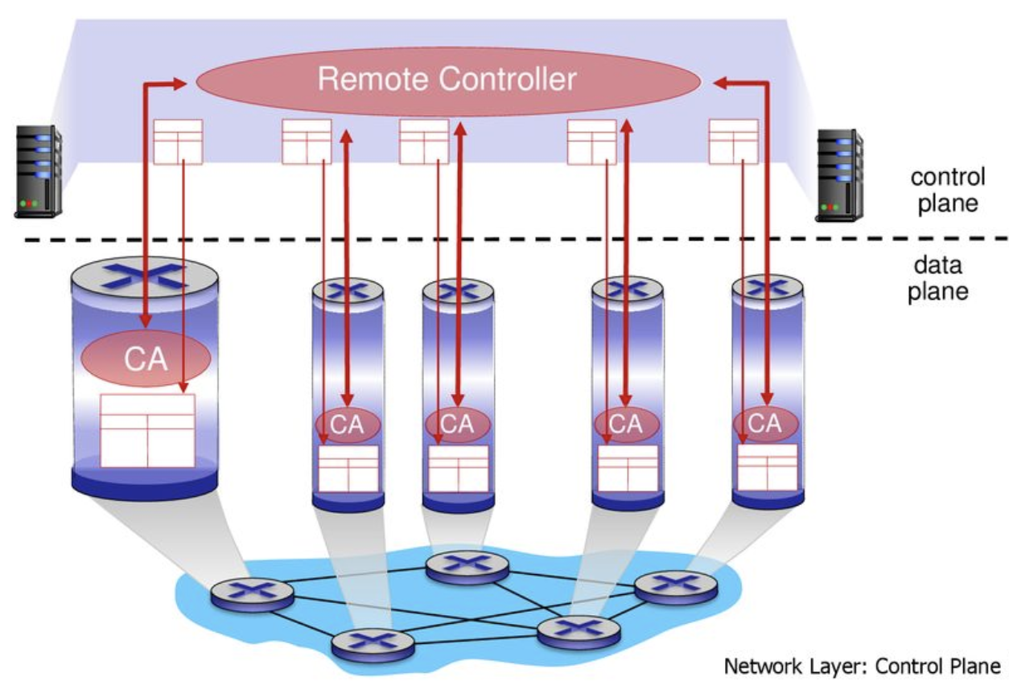
SDN-enabled Switches
A centralized controller is introduced – software-defined networking (SDN)

Slide 5
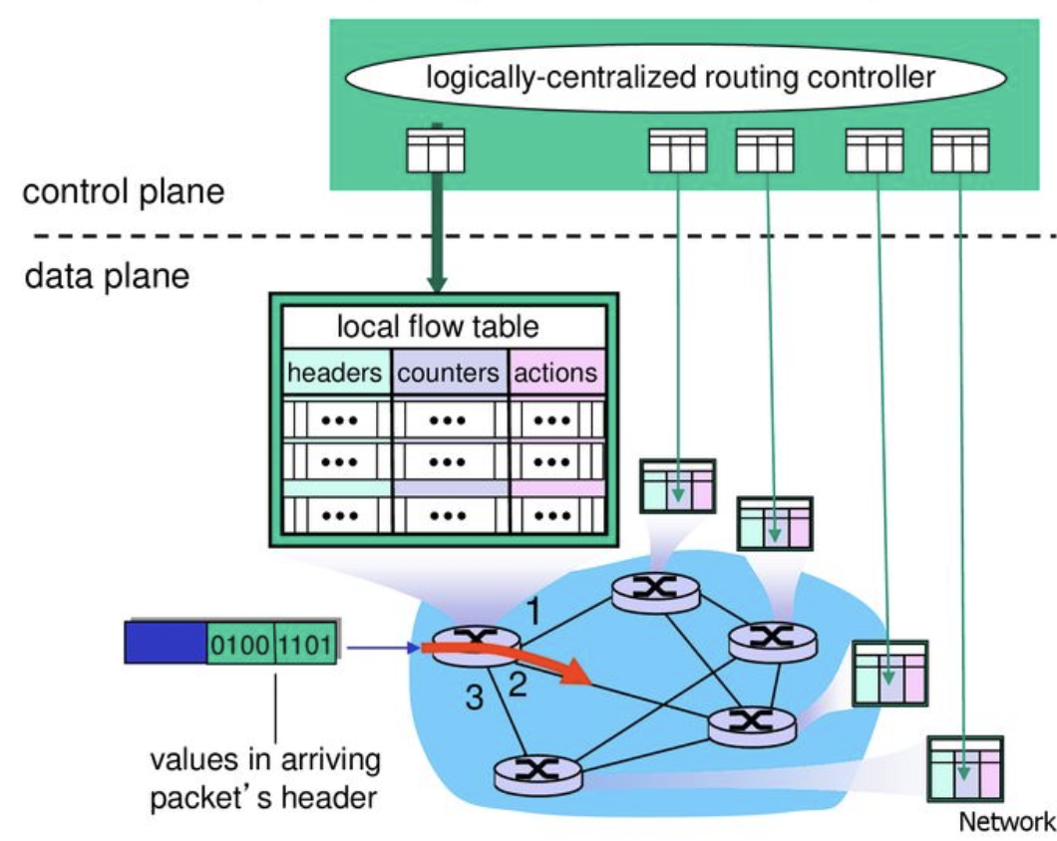
Installing Rules in the SDN-enabled Switches

Slide 6
The Routing Problem
Given the network topology and flow requests
Find a routing path for each flow
Accept the more flows → better
Requests
(src, dest; demand):
(A, F; 1)
(B, E; 1)
(A, F; 2)
1
1
B
G
D
2
1
A
2
1
F
1
3
C
E
3

Slide 7
The Routing Problem
Given the network topology and flow requests
Find a routing path for each flow
Accept the more flows → better
Requests
(src, dest; demand):
(A, F; 1)
(B, E; 1)
(A, F; 2)
1
1
B
G
D
2
1
A
2
1
F
1 (1)
3 (1)
C
E
3 (1)

Slide 8
The Routing Problem
Given the network topology and flow requests
Find a routing path for each flow
Accept the more flows → better
Requests
(src, dest; demand):
(A, F; 1)
(B, E; 1)
(A, F; 2)
1
1
B
G
D
2
1
A
2 (1)
1
F
1 (1)
3 (1)
C
E
3 (2)

Slide 9
The Routing Problem
Given the network topology and flow requests
Find a routing path for each flow
Accept the more flows → better
Requests
(src, dest; demand):
(A, F; 1)
(B, E; 1)
(A, F; 2)
1
1
B
G
D
2
1
A
2 (1)
1
F
1 (1)
3 (1)
C
E
3 (2)
The third flow will be rejected

Slide 10
The Routing Problem
Given the network topology and flow requests
Find a routing path for each flow
Accept the more flows → better
1 (1)
1 (1)
Requests
(src, dest; demand):
(A, F; 1)
(B, E; 1)
(A, F; 2)
B
G
D
2 (2)
1
A
2 (2)
1 (1)
F
1 (1)
3 (3)
C
E
3 (3)

Slide 11
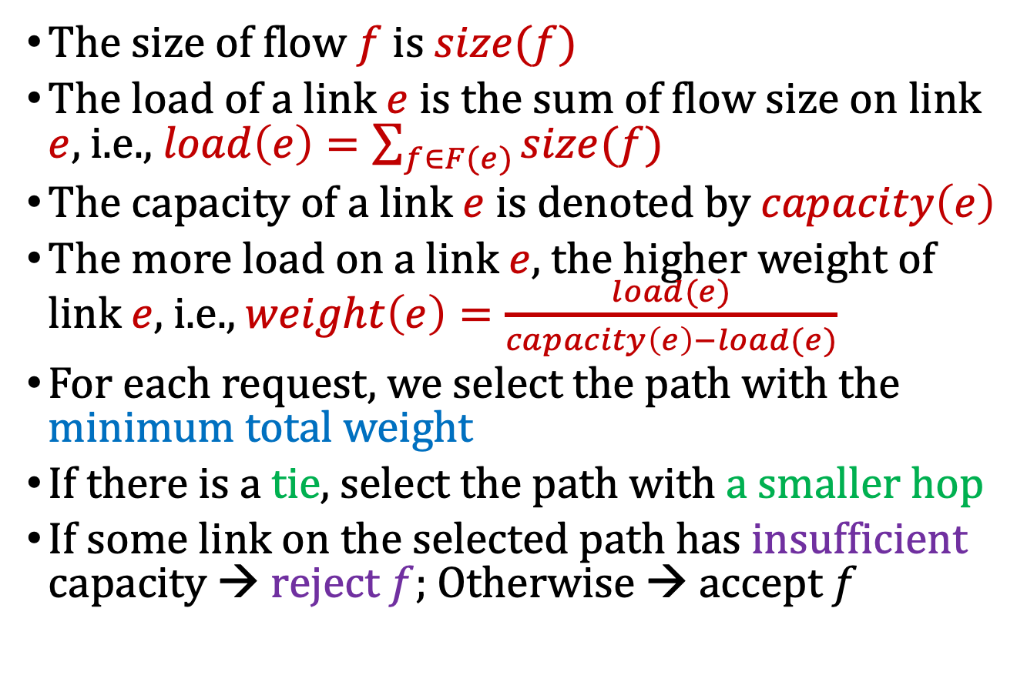
Weighted Links f0r Path Determination
The size of flow $f$ is $size(f)$
The load of a link $e$is the sum of flow size on link $e$, i.e., $load\left(e\right)=\sum_{f∈F(e)}{size(f)}$
The capacity of a link $e$ is denoted by $capacity\left(e\right)$
The more load on a link $e$, the higher weight of link $e$, i.e., $weight\left(e\right)=\frac{load(e)}{capacity\left(e\right)−load(e)}$
For each request, we select the path with the minimum total weight
If there is a tie, select the path with a smaller hop
If some link on the selected path has insufficient capacity → reject $f$; Otherwise → accept $f$

Slide 12
Weighted Links f0r Path Determination
Initially, all links are with weight 0
Choose the one with the smallest hop for the first request
Requests
(src, dest; demand):
(A, F; 1)
(B, E; 1)
(A, F; 2)
1
1
B
G
D
2
1
A
2
1
F
1 (1)
3 (1)
C
E
3 (1)

Slide 13

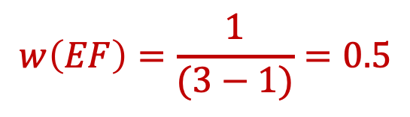
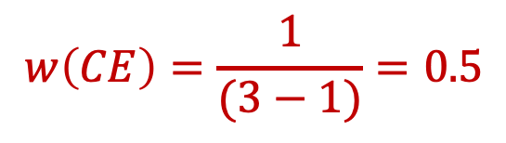
Weighted Links f0r Path Determination
Update the weight of links
$$w\left(CE\right)=\frac{1}{(3−1)}=0.5$$
$$w\left(AC\right)=∞$$
$$w\left(EF\right)=\frac{1}{(3−1)}=0.5$$
Requests
(src, dest; demand):
(A, F; 1)
(B, E; 1)
(A, F; 2)
1
1
B
G
D
2
1
A
2
1
F
1 (1)
3 (1)
C
E
3 (1)

Slide 14
Weighted Links f0r Path Determination
Select the path with the smallest total weight for the second request (i.e., 0)
We do not select the shorter one since its weight = 0.5 > 0
1 (1)
1 (1)
Requests
(src, dest; demand):
(A, F; 1)
(B, E; 1)
(A, F; 2)
B
G
D
2
1
A
2
1 (1)
F
1 (1)
3 (1)
C
E
3 (1)

Slide 15
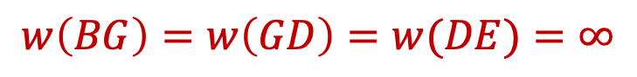
Weighted Links f0r Path Determination
Update the weight of links
$$w\left(BG\right)=w\left(GD\right)=w(DE)=∞$$
1 (1)
1 (1)
Requests
(src, dest; demand):
(A, F; 1)
(B, E; 1)
(A, F; 2)
B
G
D
2
1
A
2
1 (1)
F
1 (1)
3 (1)
C
E
3 (1)

Slide 16
Weighted Links f0r Path Determination
Select the path with the smallest total weight for the third request
1 (1)
1 (1)
Requests
(src, dest; demand):
(A, F; 1)
(B, E; 1)
(A, F; 2)
B
G
D
2 (2)
1
A
2 (2)
1 (1)
F
1 (1)
3 (3)
C
E
3 (3)

Slide 17
The Online Routing Problem
The requests arrive in an online fashion
Accept the more flows → better
Requests
(src, dest; demand):
(A, F; 1)
(B, E; 1)
(A, F; 2)
1
1
B
G
D
2
1
A
2
1
F
1
3
C
E
3

Slide 18
Another Difficulty: TCAM Limit
Every flow uses an entry in the switch on its path
A switch may process more than 10,000 flows
Recall that TCAM size is typically limited to a few thousand entries
1 (1)
1 (1)
Requests
(src, dest; demand):
(A, F; 1)
(B, E; 1)
(A, F; 2)
B
G
D
2 (2)
1
A
2 (2)
1 (1)
F
1 (1)
3 (3)
C
E
3 (3)

Slide 19
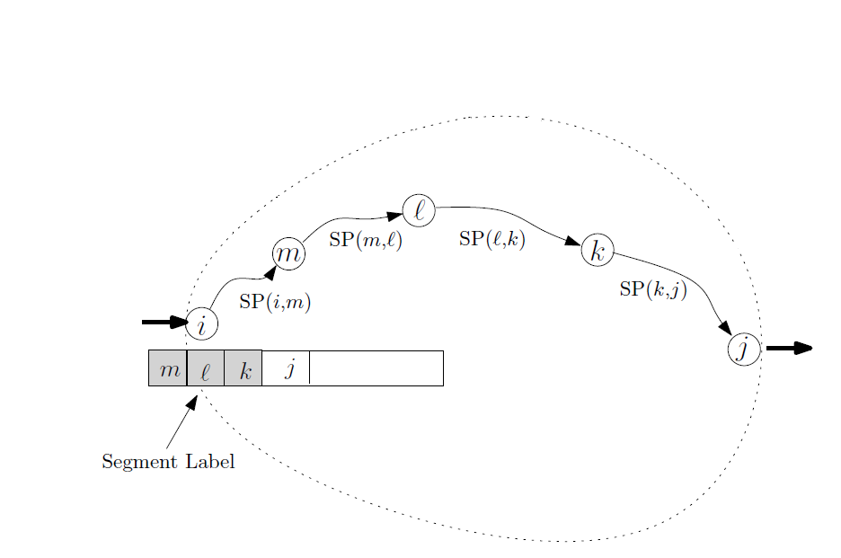
Remedy the Issue: Segment Routing
Idea: break the routing path into segments
Pre-install the segments in the switches
C. Filfils et al., “Segment Routing Architecture,” IETF, Internet Draft, Dec. 2013

Slide 20
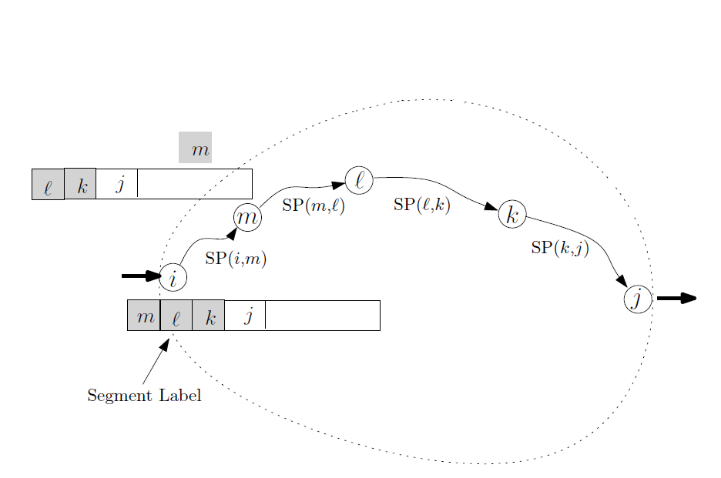
Remedy the Issue: Segment Routing
Idea: break the routing path into segments
Pre-install the segments in the switches
C. Filfils et al., “Segment Routing Architecture,” IETF, Internet Draft, Dec. 2013

Slide 21
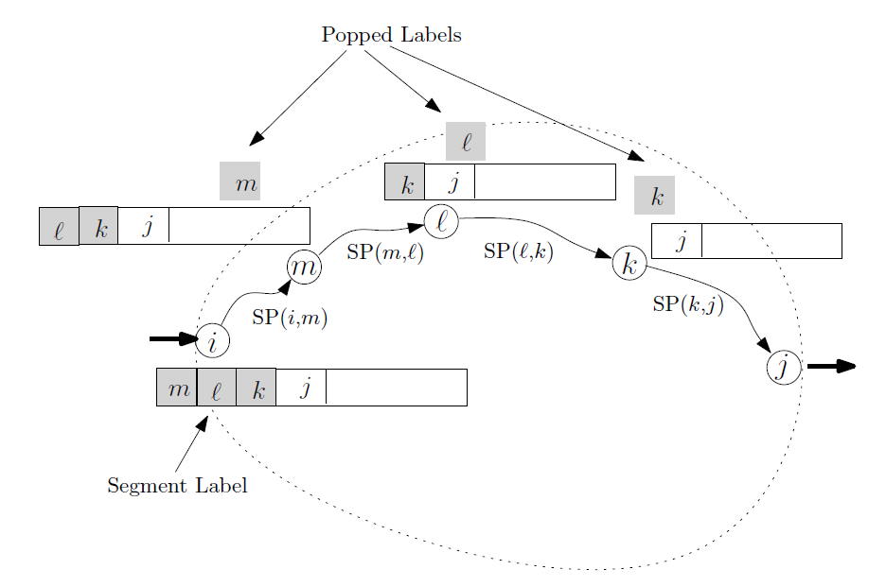
Remedy the Issue: Segment Routing
Idea: break the routing path into segments
Pre-install the segments in the switches
C. Filfils et al., “Segment Routing Architecture,” IETF, Internet Draft, Dec. 2013

Slide 22
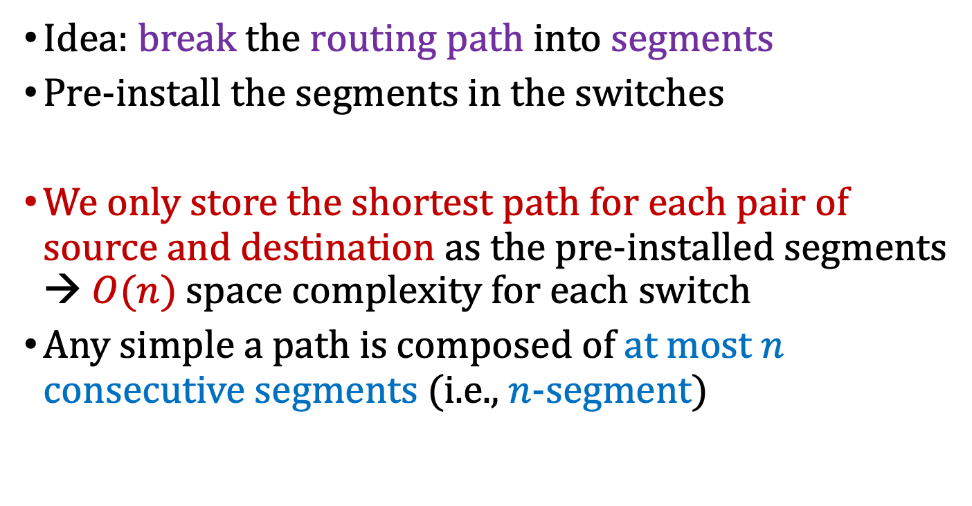
Remedy the Issue: Segment Routing
Idea: break the routing path into segments
Pre-install the segments in the switches
We only store the shortest path for each pair of source and destination as the pre-installed segments → $O(n)$ space complexity for each switch
Any simple a path is composed of at most $n$ consecutive segments (i.e., $n$-segment)
C. Filfils et al., “Segment Routing Architecture,” IETF, Internet Draft, Dec. 2013

Slide 23
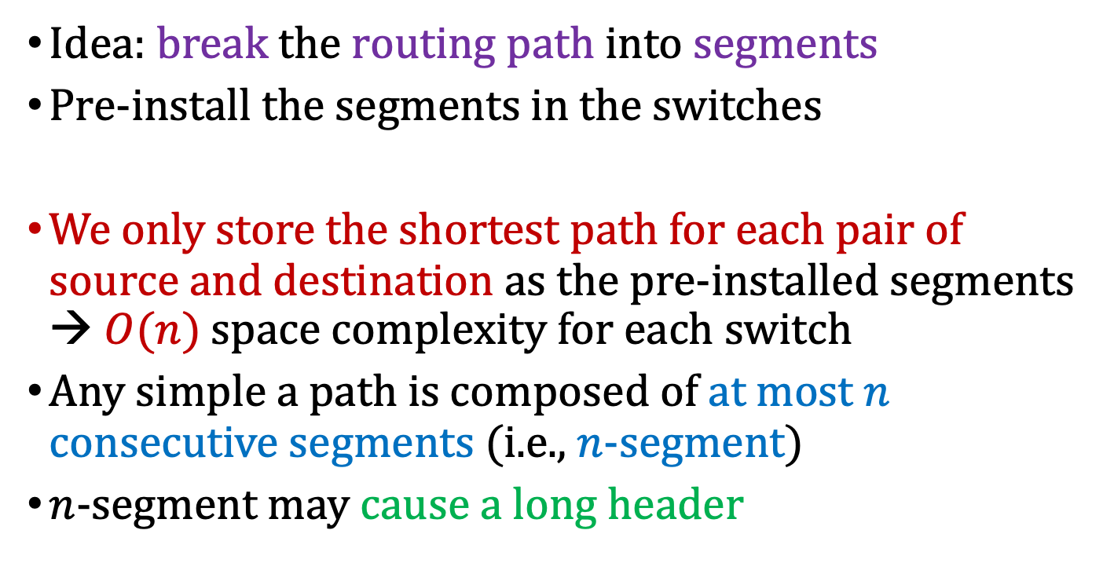
Remedy the Issue: Segment Routing
Idea: break the routing path into segments
Pre-install the segments in the switches
We only store the shortest path for each pair of source and destination as the pre-installed segments → $O(n)$ space complexity for each switch
Any simple a path is composed of at most $n$ consecutive segments (i.e., $n$-segment)
$n$-segment may cause a long header
How about using only 2-segment?
C. Filfils et al., “Segment Routing Architecture,” IETF, Internet Draft, Dec. 2013

Slide 24
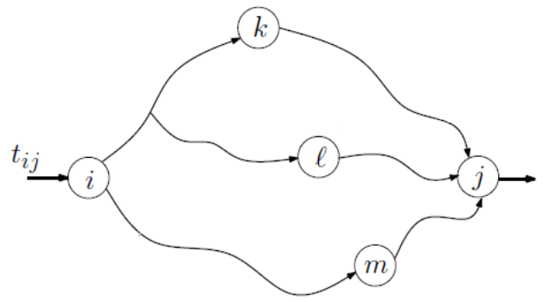
Online 2-Segment Routing
The request arrives over the time
Accept or reject the request at the arrival
Only consider the 2-segement routing path
Select and combine two segments with the smallest total weight
Bhatia et al., “Optimized Network Traffic Engineering using Segment Routing,” in IEEE INFOCOM 2015

Slide 25
Online 2-Segment Routing Problem
The requests arrive in an online fashion
Accept the more flows → better
Every path consists of two segments
Requests
(src, dest; demand):
(A, F; 1)
(B, E; 1)
(A, F; 2)
1
1
B
G
D
2
1
A
2
1
F
1
3
C
E
3

Slide 26
Online 2-Segment Routing Problem
First, compute the all-pair shortest paths
{A}, {A, B}, {A, C}, {A, B, G, D}, {A, C, E}, {A, C, E, F}, {A, B, G},…; Note that {A, C, E, D} is not selected since B’s ID < C’s ID (be carefully!!!)
Requests
(src, dest; demand):
(A, F; 1)
(B, E; 1)
(A, F; 2)
1
1
B
G
D
2
1
A
2
1
F
1
3
C
E
3

Slide 27
Online 2-Segment Routing Problem
Initially, all links are with weight 0
Requests
(src, dest; demand):
(A, F; 1)
(B, E; 1)
(A, F; 2)
1
1
B
G
D
2
1
A
2
1
F
1
3
C
E
3

Slide 28
Online 2-Segment Routing Problem
Examine all 2-segment routing from A to F, i.e., {A}+{A, C, E, F}, {A, B}+{B, C, E, F}, {A, C}+{C, E, F}, {A, B, G, D}+{D, F}, {A, C, E}+{E, F}, {A, C, E, F}+{F}, {A, B, G}+{G, D, F}
Requests
(src, dest; demand):
(A, F; 1)
(B, E; 1)
(A, F; 2)
1
1
B
G
D
2
1
A
2
1
F
1
3
C
E
3

Slide 29
Online 2-Segment Routing Problem
Select path {A}+{A, C, E, F} since it has weight 0 and the smallest number of hops
Requests
(src, dest; demand):
(A, F; 1)
(B, E; 1)
(A, F; 2)
1
1
B
G
D
2
1
A
2
1
F
1 (1)
3 (1)
C
E
3 (1)

Slide 30
Online 2-Segment Routing Problem
Update the weight of links
$$w\left(CE\right)=\frac{1}{(3−1)}=0.5$$
$$w\left(AC\right)=∞$$
$$w\left(EF\right)=\frac{1}{(3−1)}=0.5$$
Requests
(src, dest; demand):
(A, F; 1)
(B, E; 1)
(A, F; 2)
1
1
B
G
D
2
1
A
2
1
F
1 (1)
3 (1)
C
E
3 (1)

Slide 31
Online 2-Segment Routing Problem
Examine all 2-segment routing from B to E, i.e., {B, A}+{A, C, E}, {B}+{B, C, E}, {B, C}+{C, E}, {B, G, D}+{D, E}, {B, C, E}+{E}, {B, C, E, F}+{F, E} {B, G}+{G, D, E}
1 (1)
1 (1)
Requests
(src, dest; demand):
(A, F; 1)
(B, E; 1)
(A, F; 2)
B
G
D
2
1
A
2
1 (1)
F
1 (1)
3 (1)
C
E
3 (1)

Slide 32
Online 2-Segment Routing Problem
Select path {B, G, D}+{D, E} since it has weight 0
1 (1)
1 (1)
Requests
(src, dest; demand):
(A, F; 1)
(B, E; 1)
(A, F; 2)
B
G
D
2
1
A
2
1 (1)
F
1 (1)
3 (1)
C
E
3 (1)

Slide 33
Online 2-Segment Routing Problem
Update the weight of links
$$w\left(BG\right)=w\left(GD\right)=w(DE)=∞$$
1 (1)
1 (1)
Requests
(src, dest; demand):
(A, F; 1)
(B, E; 1)
(A, F; 2)
B
G
D
2
1
A
2
1 (1)
F
1 (1)
3 (1)
C
E
3 (1)

Slide 34
Online 2-Segment Routing Problem
Examine all 2-segment routing from A to F, i.e., {A}+{A, C, E, F}, {A, B}+{B, C, E, F}, {A, C}+{C, E, F}, {A, B, G, D}+{D, F}, {A, C, E}+{E, F}, {A, C, E, F}+{F}, {A, B, G}+{G, D, F}
1 (1)
1 (1)
Requests
(src, dest; demand):
(A, F; 1)
(B, E; 1)
(A, F; 2)
B
G
D
2
1
A
2
1 (1)
F
1 (1)
3 (1)
C
E
3 (1)

Slide 35
Online 2-Segment Routing Problem
Select path {A, B}+{B, C, E, F} since it has the smallest total weight (i.e., 0.5+0.5=1) for the third request
1 (1)
1 (1)
Requests
(src, dest; demand):
(A, F; 1)
(B, E; 1)
(A, F; 2)
B
G
D
2 (2)
1
A
2 (2)
1 (1)
F
1 (1)
3 (3)
C
E
3 (3)

Slide 36
Breaking a Tie All-pair shortest paths
Two shortest path have the same hops → Choose the path with the smaller node ID in sequence
Shortest path from A to D: {A, B, G, D} vs {A, C, E, D} → choose {A, B, G, D}
1
1
B
G
D
2
1
A
2
1
F
1
3
C
E
3

Slide 37
Breaking a Tie Choosing 2-Segment Routing Path
Two 2-segment routing paths have the same total weight → Choose the path with fewer hops
If they still have the same hops → Choose the path with the smaller node ID in sequence
1
H
1
Four 2-segment routing paths from A ->F:
A->B->H->D->F: weight = 0
A->C->G->E->F: weight = 0
A->B->D->F: weight = 100
A->C->H->E: weight = 100
B
D
2
1
Weight = 100
1
A
2
1
F
Weight = 100
1
1
3
C
E
3
G
3

Slide 38
Breaking a Tie Choosing 2-Segment Routing Path
Two 2-segment routing paths have the same total weight → Choose the path with fewer hops
If they still have the same hops → Choose the path with the smaller node ID in sequence
1
H
1
Four 2-segment routing paths from A ->F:
A->B->H->D->F: weight = 0
A->C->G->E->F: weight = 0
A->B->D->F: weight = 100
A->C->H->E: weight = 100
B
D
2
1
Weight = 100
1
A
2
1
F
Weight = 100
1
1
3
C
E
3
G
3

Slide 39
Breaking a Tie Choosing 2-Segment Routing Path
Two 2-segment routing paths have the same total weight → Choose the path with fewer hops
If they still have the same hops → Choose the path with the smaller node ID in sequence
1
H
1
Four 2-segment routing paths from A ->F:
A->B->H->D->F: weight = 0
A->C->G->E->F: weight = 0
A->B->D->F: weight = 100
A->C->H->E: weight = 100
B
D
2
1
Weight = 100
1
A
2
1
F
Weight = 100
1
1
3
C
E
3
G
3

Slide 40
Programming Project #3: Accept or reject a flow with 2-segment routing
Input:
Number of nodes and undirected links
Each link has the non-negative link capacity
Requests with their sources, destinations, and flow size
Procedure:
Accept or reject the flow one by one
If you accept the flow, then assign a path for the flow
Output:
Number of accepted flows
Total throughput
The assigned paths of each accepted flow
Implement the given algorithm to select the flows

Slide 41
Discussion
Maximizing the throughput is NP-hard
You cannot find an efficient algorithm for this problem unless NP = P
There are many heuristic algorithms
“Optimized Network Traffic Engineering using Segment Routing,” in IEEE INFOCOM 2015
“Dynamic Routing for Network Throughput Maximization in Software-Defined Networks,” in INFOCOM 2016
…

Slide 42
Input Sample: input.txt
Format:
#nodes #undirectedLinks
linkID firstNodeID secondNodeID linkCapacity
…
#requestFlows
flowID sourceID destinationID flowSize
…

Slide 43
Input Sample: input.txt
Format:
7 9
0 0 1 2
1 0 2 1
2 1 2 2
3 1 6 1
4 2 4 3
5 3 4 1
6 3 5 1
7 3 6 1
8 4 5 3
3
0 0 5 1
1 1 4 1
2 0 5 2
Requests
(src, dest; demand):
(A, F; 1)
(B, E; 1)
(A, F; 2)

Slide 44
Output Sample: use printf
Format:
3 4
0 0 2 4 5
1 1 6 3 4
2 0 1 2 4 5

Slide 45
Note
Superb deadline: 11/26 Tue (視情況後延一次)
考慮準時繳交的小老師額外加分
Deadline: 12/3 Tue (視情況後延一次)
Submit your code to E-course2
Demonstrate your code in 工院1館 401B
C Source code
Show a good programming style

Slide 46
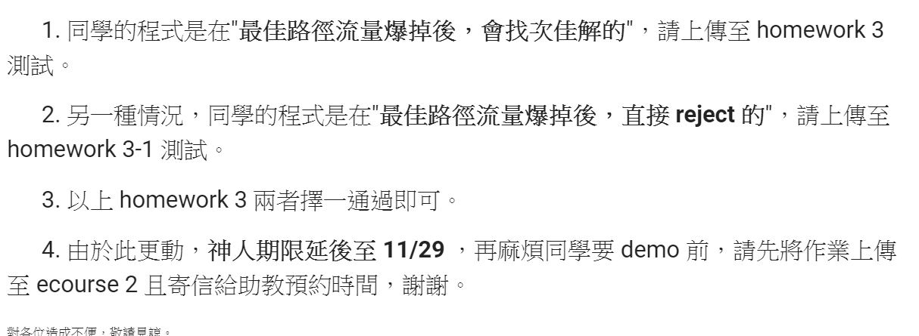
繳交說明

Slide 47
0
0
4
2
1
5
1
2
3
6
3
7
0
1
2
3
1
2
3
0
1
2
3
4
5
6
7
1
2
0
2
3
0
3
0
1
3
0
3
0
1
2
1
2
G₁
0
5
4
6
0
1
2
1
5
7
0
2
1
6
G₃
G₄
2
An undirected graph with n vertices and e edges ➔ n head nodes and 2e list nodes

Slide 48
最短路徑
The Shortest Path

Slide 49
The Shortest Path(最短路徑)
由某節點到其他各個節點之最短路徑。
各個節點之間最短路徑。
最短路徑的定義 : 一條從節點S到節點D最短路徑P，它的總權重最少：

Slide 50
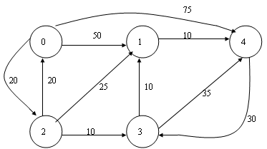
單一起點到其他節點最短路徑
採用貧婪(Greedy)策略
如圖是沒有負權重的網路 設起點為0，求節點0到節點1 最短路徑
節點0到 1，路徑長原為50， 經由節點2，路徑 0 -> 2 -> 1 ，路徑為45 ，然不滿足， 繼續尋找得到路徑0 -> 2 -> 3 -> 1 ，路徑長40為最短。

Slide 51
Dijkstra’s演算法則
要找出某一頂點到其他節點的最短路徑，可利用Dijkstra’s演算法求得。
其過程如下：

Slide 52
D = A [F, I] ( I =1, N ) S = {F} V = {1, 2, … , N} D為N個位置的陣列，用來儲存某一頂點到其他頂點的最短距離，F表示由某一起始點開始，A [F, I]是表示F點到I點的距離，V是網路中所有頂點的集合，S也是頂點的集合。
從V－S集合中找一頂點t，使得D [t]是最小值，並將t放入S集合，一直到V－S是空集合為止。
根據下面的公式調整D陣列中的值： D [I] = min ( D [I], D [t] +A [t, I; ] ((I , t )∈E) 其中I是指t的相鄰各頂點。
繼續回到(2)執行。

Slide 53
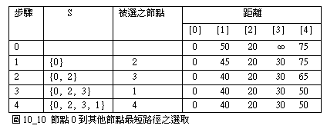
演算法
＝＞圖解演算法

Slide 54
＝＞演算虛擬碼
若Procedure SHORTEST_PATH (v, COST, DIST, n)
Declare S (1 : n )
for j ← 1 to n
S( j )← 0 ; DIST( j )←COST( v , j )
End
S( v )←1 ; DIST( v )←0 ; num←2
While num < n do
Choose u : DIST(u) = min{DIST(w)}
S(u)←1 ; num←num+1
For all w with S(w) = 0 do
DIST(w) ←min {DIST(w), DIST(u) + COST(u , w ) }
end
end
end SHORTEST_PATH

Slide 55
＝＞演算程式碼
同樣的，我們可以將Dijkstra演算法，以C語言表達如下：
#define N 6
#define MAX_I 10000
int adj_matrix [N][N]
int path [N], dist [N], s[N];

Slide 56
dijkstra ( int v)
{
int i , j , m , min , s[N] ;
for ( i = 0 ; i < N ; i ++)
{
dist [i] = adj_matrix [v][i] ;
s [i] = 0 ;
path [i] = v ;
}
s [v] = 1 ;

Slide 57
for ( i = 0 ; i < N – 2 ; i ++ )
min = MAX_I ;
for ( j = 0 ; j < N ; j ++)
if ( dist [j] < min && s [j] = = 0)
{
min = dist [j] ;
m = j ;
}

Slide 58
s [m] = 1 ;
for ( j = 0 ; j < N ; j ++)
{
if ( dist [j] > dist [m] + adj_matrix [m][j])
{
dist [j] = dist [m] + adj_matrix [m][j] ;
path [j] = m ;
}
}
}
}

Slide 59
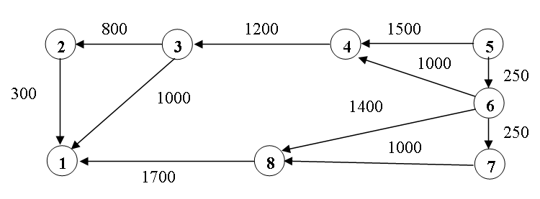
範例
Iteration | S | Vertex Selected | DIST
Initial 1 2 3 4 5 6 | 5 5,6 5,6,7 5,6,7,4 5,6,7,4,8 5,6,7,4,8,3 5,6,7,4,8,3,2 | － 6 7 4 8 3 2 |  | ∞ ∞ ∞ ∞ 3350 3350 | ∞ ∞ ∞ ∞ ∞ 3250 | ∞ ∞ ∞ 2450 2450 2450 | 1500 1250 1250 1250 1250 1250 | 0 0 0 0 0 0 | 250 250 250 250 250 250 | ∞ 1150 1150 1150 1150 1150 | ∞ 1650 1650 1650 1650 1650

Slide 60
公開測資
7
Input
8 11
0 0 1 3
1 0 2 1
2 0 5 1
3 1 5 4
4 1 6 3
5 2 3 1
6 3 4 3
7 4 5 3
8 4 7 2
9 5 6 4
10 6 7 2
3
0 0 7 1
1 3 6 2
2 0 6 1
2
2
3
4
4
5
6
4
1
3
3
3
0
1
1
3
2
1

Slide 61
公開測資
7
output
3 4
0 0 1 6 7
1 3 4 5 6
2 0 1 6
Input
8 11
0 0 1 3
1 0 2 1
2 0 5 1
3 1 5 4
4 1 6 3
5 2 3 1
6 3 4 3
7 4 5 3
8 4 7 2
9 5 6 4
10 6 7 2
3
0 0 7 1
1 3 6 2
2 0 6 1
2
2
3
4
4
5
6
4
1
3
3
3
0
1
1
3
2
1

Slide 62
公開測資
7
output
3 4
0 0 1 6 7
1 3 4 5 6
2 0 1 6
Input
8 11
0 0 1 3
1 0 2 1
2 0 5 1
3 1 5 4
4 1 6 3
5 2 3 1
6 3 4 3
7 4 5 3
8 4 7 2
9 5 6 4
10 6 7 2
3
0 0 7 1
1 3 6 2
2 0 6 1
2
2(1)
3
4
4
5
6
4
1
3(1)
3(1)
3
0
1
1
3
2
1

